Slide 1
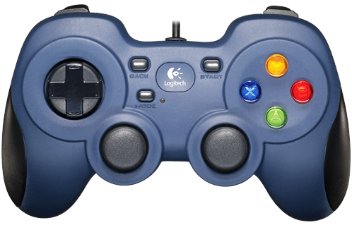
Bumpers activate and deactivate modes
Trigger
Latches
Reverse motors
Activate and deactivate arcade
Safety mode
Tank Drive
& Arcade
Click
Slow mode and normal
Intake motor

